Slide 1


Creating Live Dashboards – using Data Visualization Tools
Review 1
H - Slot ( MGT 1002 )
LEAN STARTUP MANAGEMNET
Fall semester 2020 - 2021

Slide 2


Name | GUDI VARAPRASAD
Reg No. | 19BCE7048
Email | gudi.varaprasad@gmail.com
City | Hanamkonda, Warangal (Urban)
State | Telangana - 506009
Course : MGT 1002 – Lean Startup Management
Slot : H + TH
Faculty Facilitator : Prof. Samuel Johnson.K
( VIT AP School of Business (VSB) )

Slide 3

TOPIC : Business Impact due to COVID 19 in India
Objectives of the Topic :
COVID - 19 impact on Indian Business economy 2020.
Estimated economic impact from COVID-19 on India's GVA 2020 by sector.
Loss as % of GSDP due to COVID -19 on Indian Businesses 2020.
Estimated impact from COVID - 19 on India's GDP 2020.
Opinion on the COVID - 19 impacting Indian startups and SMEs in April 2020.
3

Slide 4
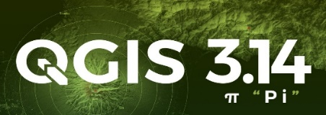

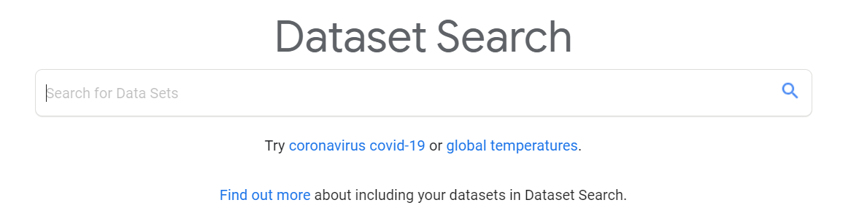






Tools used
Quantum Geographic Information System ( QGIS )
Infogram
Google Data Search
Statista
data.world
YouTube QGIS tutorial
ColorBrewer
Microsoft Excel Sheets
4

Slide 5


Web Tools Links ( free Open Source or Paid tools )
QGIS
Infogram
Google Data Search
Statista
YouTube QGIS Tutorial
ColorBrewer
data.world
- an Open Source GIS
- Paid tool for premium users but free with limited features
- an Open Source data search tool
- Paid tool for premium users but free with limited datasets
- an Open Source tutorials on QGIS
- an Open Source colour advice for cartography
- an Open Source data search tool
5

Slide 6

Links of the project ( Review 1 )
Estimated economic impact from COVID-19 on India's GVA 2020 by sector
Estimated impact from COVID-19 on India's GDP 2020
Opinion on the impact of COVID-19 on Indian Businesses 2020
Opinion on COVID-19 impacting Indian startups and SMEs 2020
Loss as % of GSDP during COVID - 19 on Indian Businesses 2020
6

Slide 7
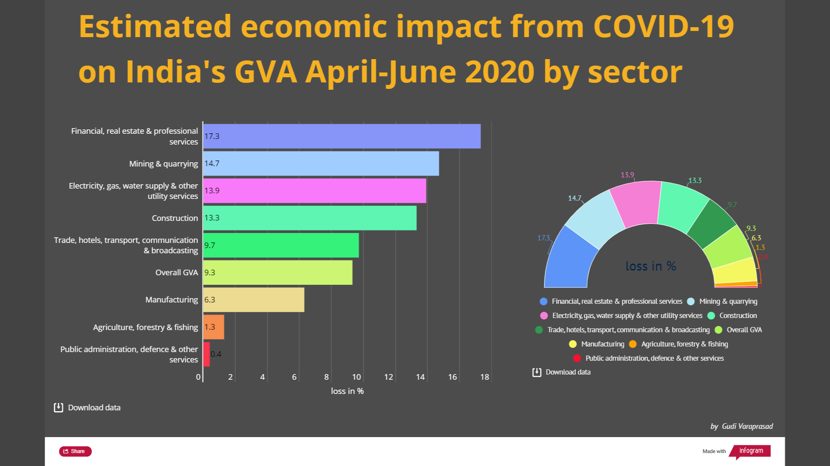
Print screen of Dashboard 1
7

Slide 8
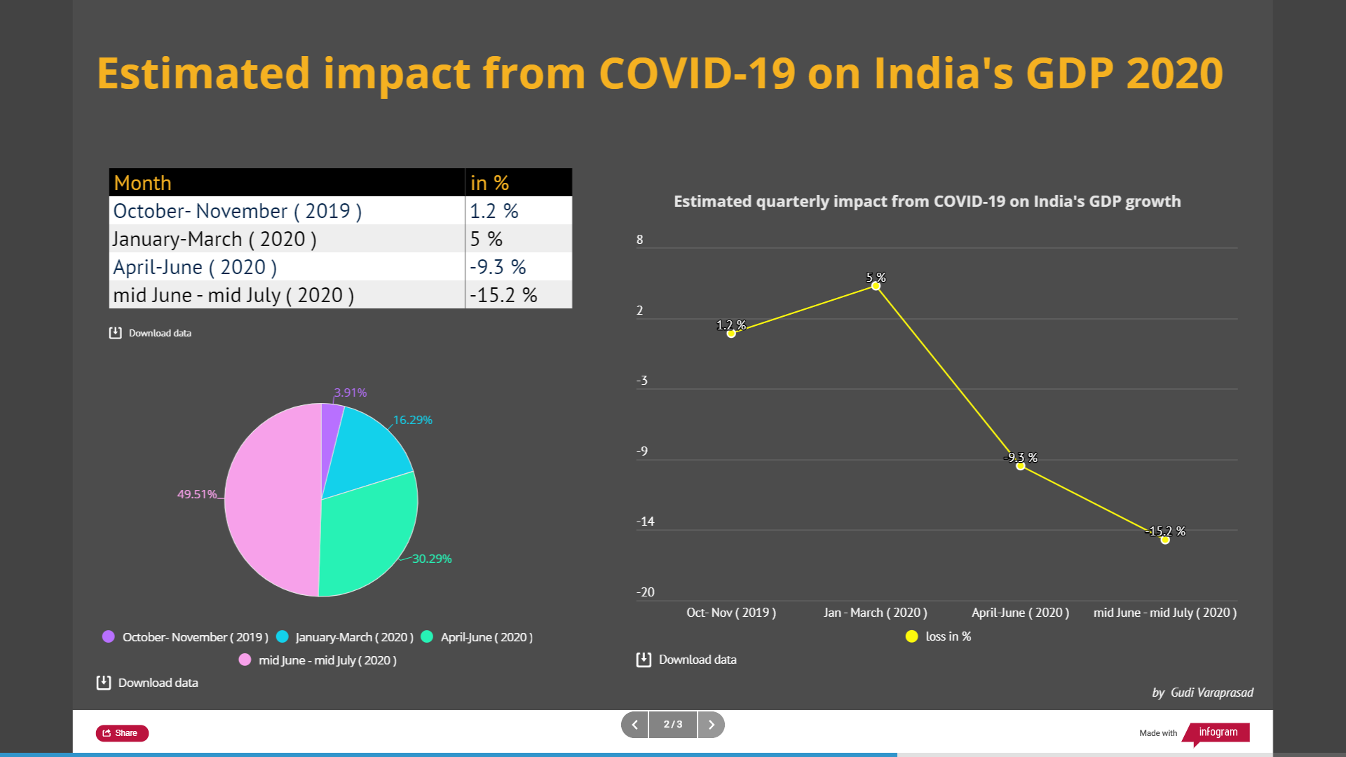
Dashboard 2
8

Slide 9
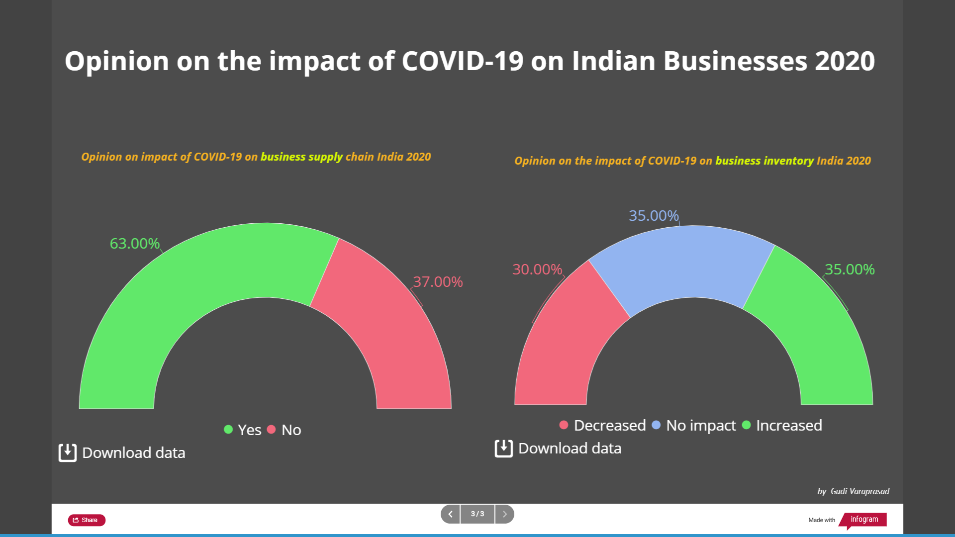
Dashboard 3
9

Slide 10
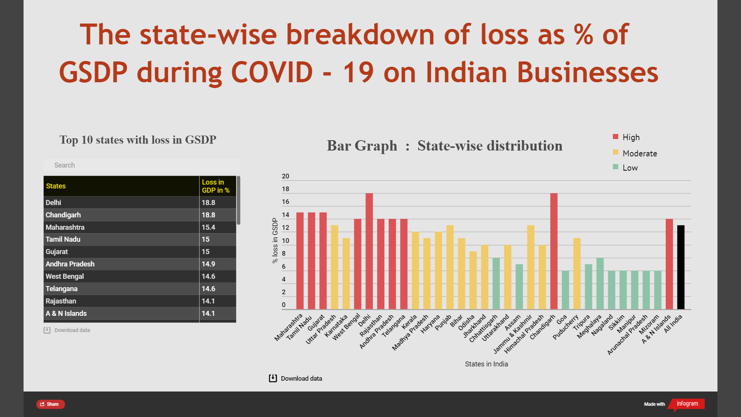
Dashboard 4.a ( using Infogram )
10

Slide 11
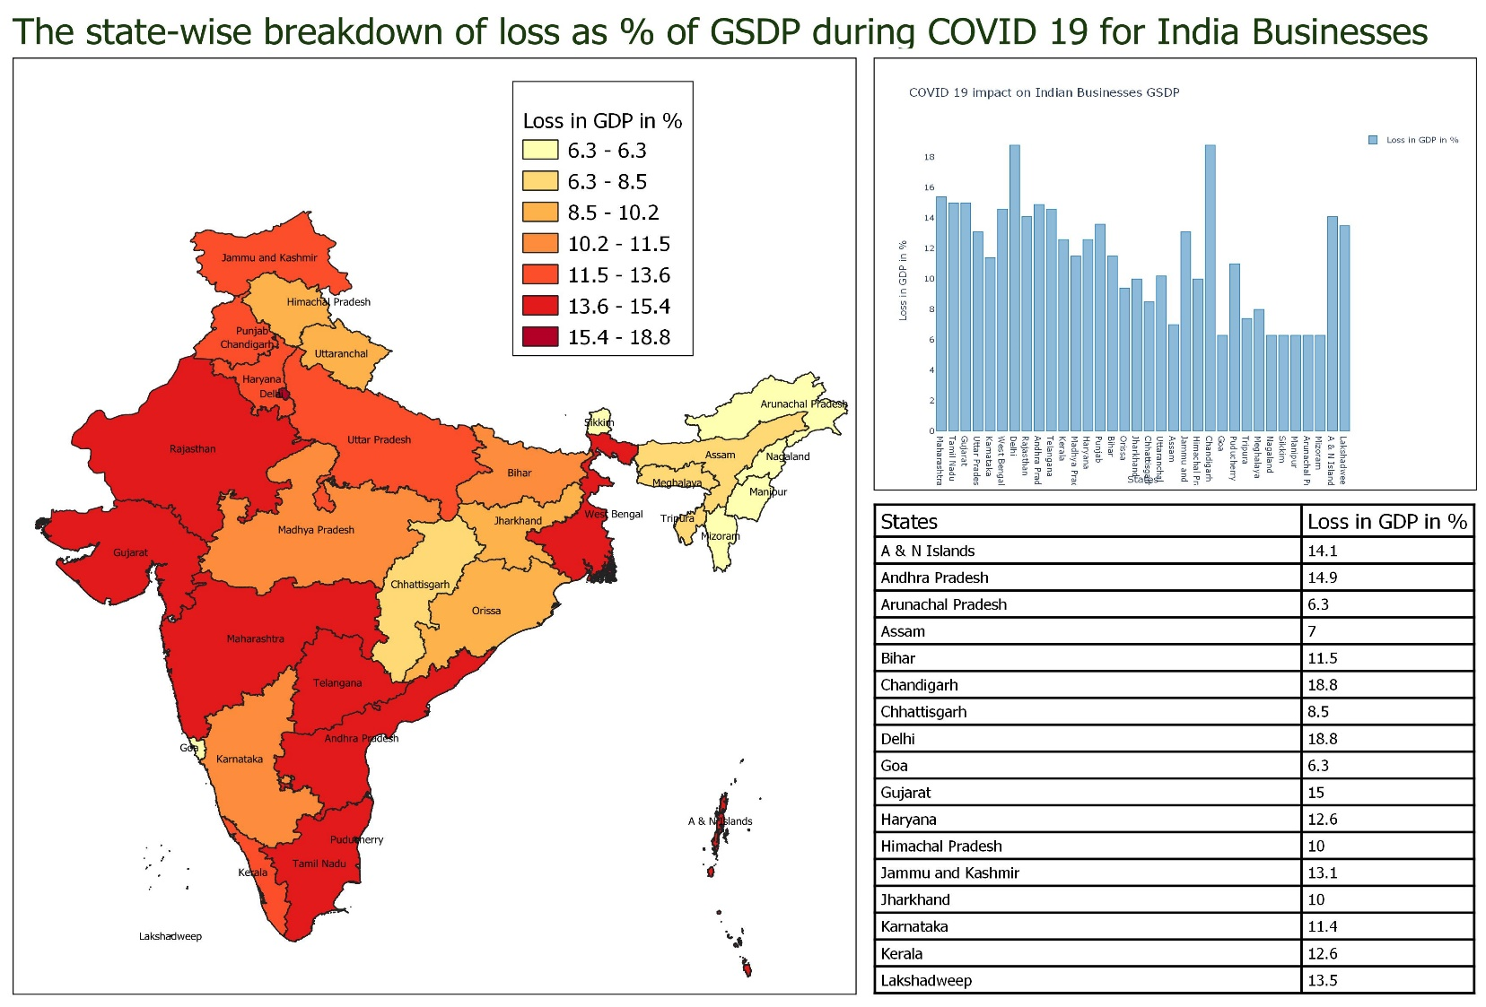

Dashboard 4.b ( using QGIS )
11

Slide 12
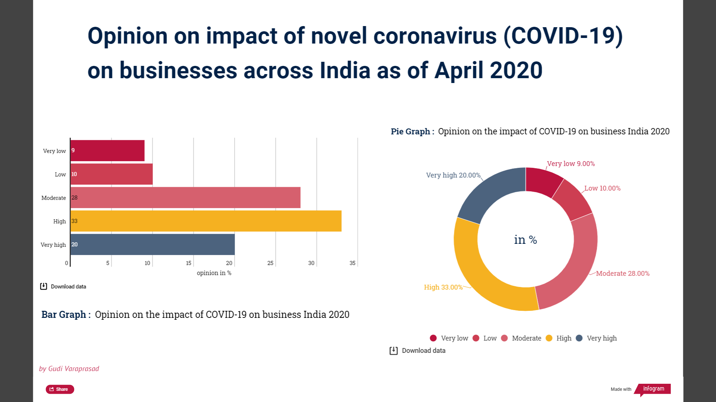
Dashboard 5
12

Slide 13
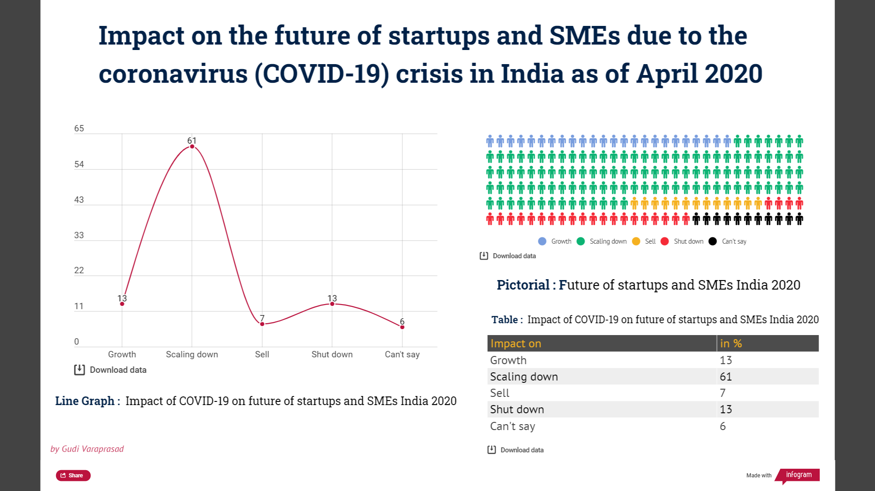
Dashboard 6
13

Slide 14
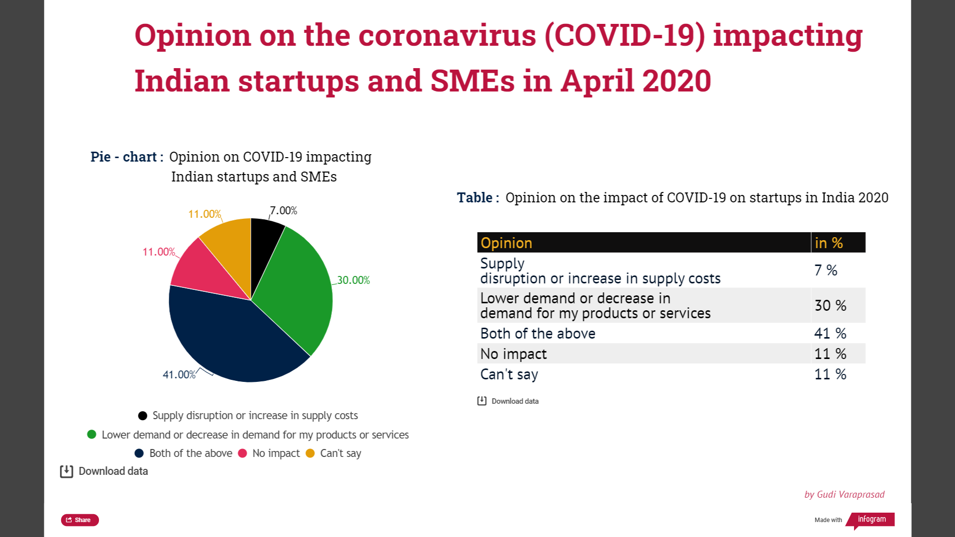
Dashboard 7
14

Slide 15

Tools learnt
Quantum Geographic Information System ( QGIS )
Infogram - Dashboard
Google Data Search
Statista
data.world
ColorBrewer
Microsoft Excel

Slide 16

Challenges I faced ….
I didn’t have any clue regarding the topic, project.
I was not aware of where, what and how to begin.
I was not familiar with some tools like QGIS, Microsoft Power BI, Infogram, Microsoft Excel, etc..
So, I looked for some YouTube tutorials and tried experimenting the tool with rough dataset.
Even after exploring few research articles, It was hard to find accurate datasets.
Limited Datasets were accessible.
It was challenging to gather, organize, interpret and sort the data from the information available and collated it with excel sheets in the way required for data visualization.
16

Slide 17

What are your future additions for the remaining month of August and September 2020
Make the dataset available and downloadable to public.
Make it look more colourful, creative and informative.
Try to make it web interactive and live if possible.
Add on some more contributions or update the datasets based on the current/future impacts.
Make a YouTube tutorial or demonstration about my data visualization dashboard.
Work in future related to data visualizations and interpretations.

Slide 18

PRESENTED ANALYSED VISUALIZED
by
GUDI VARAPRASAD – 19BCE7048
Fall semester 2020 - 2021

